Slide 1
Bacteria & bacterial diseases
Ms rayner 2022

Slide 2
Description of bacteria
Bacteria are prokaryotic.
Bacteria are the most abundant and diverse group of organisms.
Only a relatively small number of bacteria cause disease.
There are billions of bacteria living on our skin and in our bodies that are not pathogenic and are often beneficial.
Bacterium is the singular term for bacteria.

Slide 3
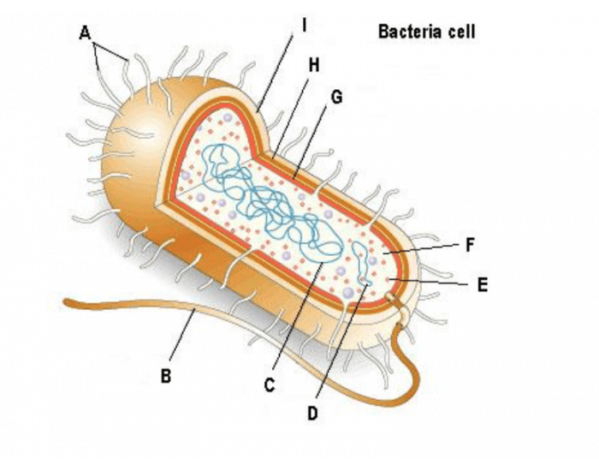
Structural characteristics of bacteria
Single celled microscopic organism 1 - 10µm (Much larger than viruses)
Prokaryotic – no membrane bound organelles
Usually Singular Circular Chromosome
Have cell wall (sugars & amino acids) and plasma membrane made of peptidoglycan
Have various shapes – spherical, spiral, rod, filamentous
Cells contain plasmids & ribosomes
Some possess flagellum

Slide 4
Diagram of bacteria
A – Pilli
B – Flagella
C – Singlular Circular Chromosome
D – Plasmid
E – Ribosome
F – Cytoplasm
G – Plasma membrane
H – Cell Wall
I – Capsule (Many bacterial cells secrete some extracellular material in the form of a capsule or a slime layer. Capsules can protect a bacterial cell from ingestion and destruction by white blood cells)

Slide 5
Comparison between virus and bacteria

Slide 6
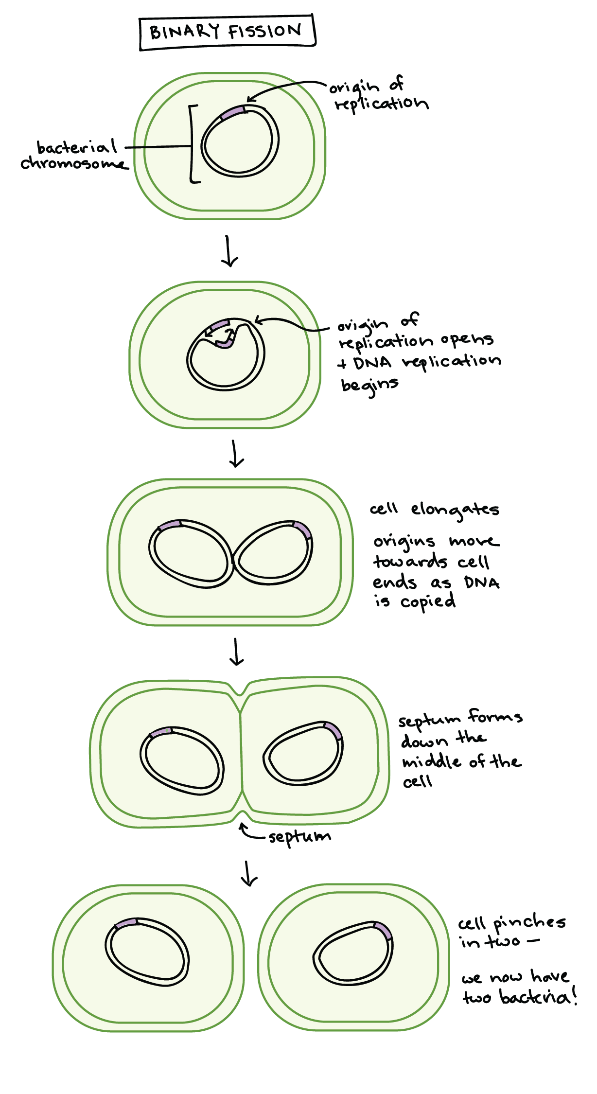
Bacteria reproduction by binary fission
One cell splits into two identical daughter cells. Binary fission begins when the DNA of the bacterium doubles in quantity then divides into two (replicates).
The bacterial cell then elongates and splits into two daughter cells, each with DNA that is identical to that of the parent cell.
Science Photo Library/CNRI

Slide 7
Bacteria classification
Bacteria can be classified according to their shape:
rod-shaped, known as bacillus (plural bacilli)
Science Photo Library/A Dowsett, Health
Protection Agency
spiral (plural spirilla)
Science Photo Library/CNRI
spherical, known as coccus (plural cocci)
Science Photo Library/CNRI
vibrio (not shown), like a comma.

Slide 8
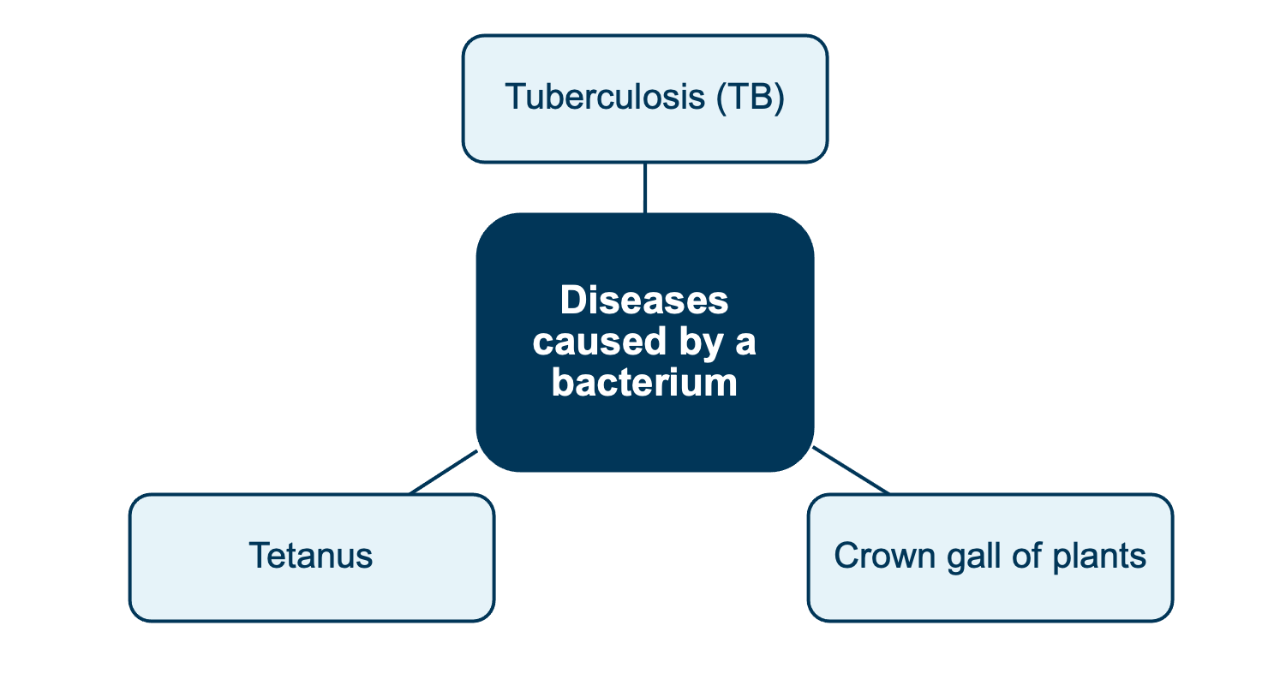
Examples of diseases caused by a bacterium

Slide 9
Biology WA Units 3 & 4
Set 12.3a pg.418 Q 1-4

Slide 10
Life Cycle – Pathogenic bacteria

Slide 11
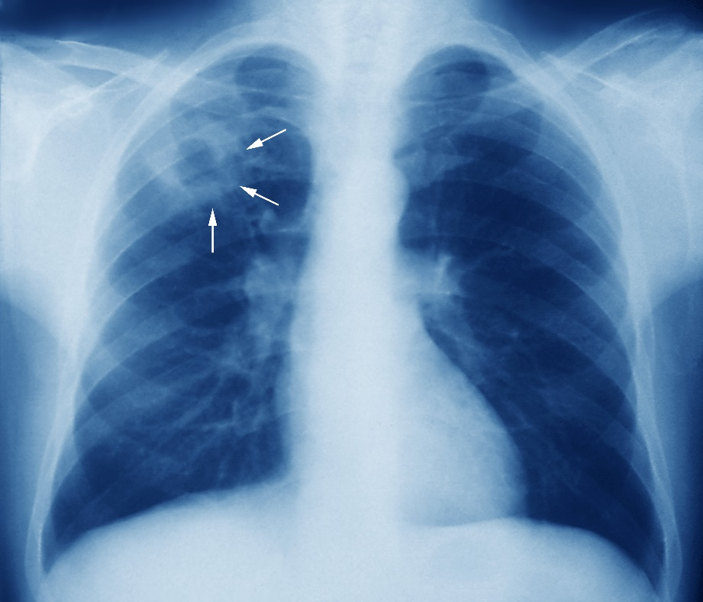
Tuberculosis (TB)
The disease tuberculosis (TB) is caused by the infectious bacterium, Mycobacterium tuberculosis.
It is not common in Australia, but is very common in many developing countries.
The tubercle-producing, rod-shaped bacterium mainly affects the lungs of the respiratory system.
(A tubercle is a small round structure made of cells that is produced as a result of the infection.)
Alamy Stock Photo/Scott Camazine

Slide 12
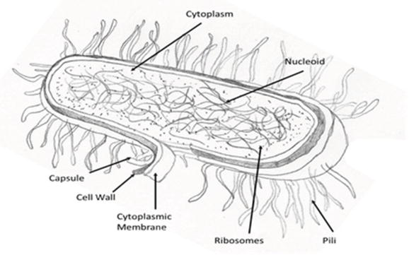
Mycobacterium tuberculosis Structure

Slide 13
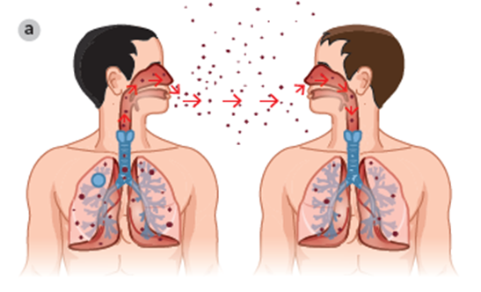
Tuberculosis mode of transmission
When a person with tuberculosis coughs, tubercle bacilli are transported in fine droplets from the infected human host’s lungs into the air, from where they can be inhaled by a susceptible person.
Direct transmission via close contact occurs when a person is standing only 1–2 metres away from the infected person and inhales the airborne droplets.

Slide 14
Tuberculosis Transmission
Indirect transmission can also occur when an infected person coughs, sending droplets into the air, because the bacilli may land on a dusty surface.
When the dust is disturbed and flies in the wind (travelling a distance), it can carry the bacteria into the air and can then be inhaled.

Slide 15
Mode of transmission influences spread
Primarily transmitted through airborne droplets – will be spread easily this way if host density if high
Depending on the environment can remain suspended in the air for long periods & air current can carry the bacteria – will spread throughout a building or from one room to another

Slide 16
Tuberculosis Life Cycle
TB infection happens in 4 stages:
the initial macrophage response,
the growth stage,
the immune control stage, and the
lung cavitation stage.
These four stages happen over roughly one month

Slide 17
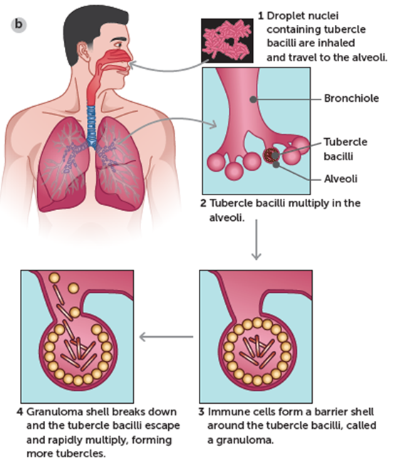
Tuberculosis Life Cycle
The first stage takes place in the first week after the inhalation of the TB bacillus.
      After the bacillus reaches the alveoli in the lung, special cells of the immune system, called macrophages within the tissue of the alveoli detect them
      The macrophages engulf the TB bacillus.
      If the amount of TB bacilli is too large, or if the macrophage is not strong enough to resist, the bacilli can reproduce in the macrophage.

Slide 18
Tuberculosis Life Cycle
If the macrophage cannot contain the TB bacillus, TB infection enters its second stage after about a week and the TB bacilli start reproducing exponentially

Slide 19
Tuberculosis Life Cycle
Stage Three
      After the third week, the bacilli do not grow exponentially anymore,
      it seems that at that stage, bacilli growth and destruction by macrophages are balanced. The body brings in more immune cells to stabilize the site, and the infection is under control.
      At least nine of ten patients infected with Mycobacterium tuberculosis stop at stage 3 and do not develop symptoms or physical signs of active disease.

Slide 20
Tuberculosis Life Cycle
      In their lungs, the TB bacilli and macrophages that swallowed them build a round complex – with TB bacilli and infected macrophages in the middle and healthy macrophages surrounding them.
      The TB bacilli are shielded from the lung tissue; however, they can survive for years in the macrophages.
      Patients in this stage are not contagious, because the TB bacilli cannot enter the airways and cannot be coughed out or exhaled. If the immune system is strong, the primary complex heals and leaves nothing more but a small cavity and a scar in the tissue.

Slide 21
Tuberculosis Life Cycle
Stage Four
      In about 5% of cases, the primary complex does not heal and the TB bacilli become re-activated after a period of 12 to 24 months after the initial infection
      The reactivated TB bacilli reproduce quickly and form a cavity in the tissue, where the body’s immune system cannot reach them.
      From this cavity, the TB bacilli quickly spread through the tissue and the person develops signs and symptoms of active TB such as coughing.

Slide 22
Tuberculosis Life Cycle
      In this stage, the person is highly contagious because his or her sputum contains active TB bacteria.
      Reactivation is more likely to happen if the immune system is weakened, such as with HIV infection or malnutrition.

Slide 23
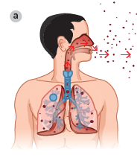
Mycobacterium tuberculosis life cycle
Infected host reservoir
Site for replication of infectious agent
Portal of exit
Mode of transmission
Portal of entry
Susceptible host

Slide 24
Symptoms & Impact on Host
TB can cause disease in any part of the body, but the lungs are the most common. Some people with TB disease may only have mild symptoms. People with TB may have some or all of the following symptoms:
        A cough that lasts for more than three weeks, and is not improving
        Blood-stained sputum
        Fevers
        Night sweats
        Unexplained weight loss
        Always feeling tired
        Loss of appetite
        Pain and / or swelling in the affected area.
  https://www.who.int/news-room/fact-sheets/detail/tuberculosis

Slide 25
Incubation period
3 – 9 weeks
TB can stay dormant in the body for months or years. While dormant the host will not show any symptoms (this is called latent TB). The host is not infectious

Slide 26
Treatment
Hosts with active (stage 4) and latent (stage 3) TB should be treated to avoid transmission (spreading the disease)
TB disease can be treated by taking a mix of antibiotics for 6 to 9 months.
There are 10 drugs currently approved by the U.S. Food and Drug Administration (FDA) for treating TB.
Of the approved drugs, the first-line anti-TB agents that form the core of treatment regimens are:
      isoniazid (INH)
      rifampin (RIF)
      ethambutol (EMB)
      pyrazinamide (PZA)

Slide 27
Antibiotics
Are antimicrobial chemicals that inhibit or destroy bacteria
They target structures only present in bacteria – structural features and metabolic characteristics
Example of Antibiotics | Action on bacteria
Streptomycin | Disrupts protein sysnthesis by binding to ribosomes
Penicillin | Disrupts cell wall growth in bacteria by interfering with the synthesis of the peptidoglycan layer in their cell wall
Clotrimazole | Disrupts cell membrane permeability

Slide 28
Prevention
Identify & diagnose disease so can receive medication/treatment
Chest X-rays or sputum tests for diagnosis of active TB
Medications
Mix of antibiotics prescribed for a period of 6 months minimum
Hygiene
Wear surgical masks
Healthcare workers wear specialist marks that are designed to protect from inhaling droplets
Cough into tissues
Quarantine
People with infectious TB are isolated until they are no longer infectious. This is particularly important in hospitals
Government healthcare workers use infection control guidelines for the prompt detection of infectious patents, airborne precautions & treatments

Slide 29
Prevention
Vaccination
People diagnosed with latent TB infection may be offered a course of preventive treatment
BCG vaccination gives protection against life-threatening forms of TB in young children who will be travelling to countries where TB is common, but it is not routinely given in Australia except to those at high risk
Education
Education of family members to reduce risk of transmission

Slide 30
Multidrug resistant TB
Multidrug resistant TB (MDR-TB) occurs when TB bacteria are resistant to at least isoniazid and rifampin, the two most powerful TB drugs. Drug susceptible TB and drug resistant TB is spread in the same way.
Multidrug resistant TB cab occur when people stop taking the drugs too soon, they can become sick again; if they do not take the drugs correctly, the TB bacteria that are still alive may become resistant to those drugs. TB that is resistant to drugs is harder and more expensive to treat (Natural Selection)

Slide 31
Multidrug resistant TB
People with MDR-TB require longer antibiotic treatment for up to 24 months, and some people need regular injections into their vein for the first 6 to 8 months
People with MDR-TB should take all their TB medicines exactly as prescribed, until the end of the treatment course, without missing doses or stopping early.

Slide 32
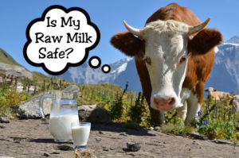
Bovine Tuberculosis
Chronic disease of animals caused by a bacteria called Mycobacterium bovis (M.bovis) it is closely related to the bacterium that caused TB in humans and birds
It is a zoonosis that can be spread to humans
M.Bovis is a Gram-positive and aerobic
It has been eradicated from Australia. The last case in Australia was in 2002
https://www.youtube.com/watch?v=wa47eNETNno

Slide 33
Transmission
transmission of M.bovis In cattle & wildlife occurs via:
Airborne Droplet Transmission
      Most commonly spread by inhalation of infected airborne droplets
M.Bovis is shed in bodily fluids so can also be transmitted when organisms come into contact with the milk, faeces, urine etc of infected individuals

Slide 34
Transmission
Transmission of M.bovis from cattle to humans occurs via:
Airborne Droplet Transmission
      Inhalation of infected airborne droplets from animals is rare, but it can be transmitted to another human this way when an infected host coughs or sneezes
Foodborne Transmission
      It is spread to humans via unpasteurized dairy products
      It can also spread to humans through eating inadequately cooked meat
Direct Transmission through breaks in the skin
      Can occur from direct contact with a wound for example during slaughter or hunting

Slide 35
Prevention
      Unpasteurized dairy products, such as milk or cheese, should not be consumed
      People at risk for contact with body fluids or tissue from a wild bison or cervid (e.g., deer or elk) into a wound, such as hunters and vets, should promptly seek medical attention and inform their healthcare providers about the exposure to a wild animal that might carry M. bovis.
      People who spend extended periods in close contact with cattle or other animals that might carry M. bovis, such as dairy workers, should promptly seek medical attention for any illness with symptoms of TB disease as described above and ensure that their health care providers are aware that they work in close contact with animals.

Slide 36
Prevention
      In countries around the world Bovine TB has become established in wildlife reservoirs, such as deer, badgers, pigs, possums in NZ and buffalo in Africa.
      To prevent the spread of TB from these wildlife populations the following control methods are used:
            Population reduction
            Replacement with disease free animals
            Biosecurity on farms to protect livestock & feed from contact with wildlife
            Vaccination of wildlife
            Wildlife free buffer areas

Slide 37
Treatment in Humans & Cattle
M. bovis is treated similarly to M. tuberculosis.
M. bovis is usually resistant to one of the antibiotics, pyrazinamide, typically used to treat TB disease. However, resistance to just pyrazinamide does not usually cause problems with treatment, because TB disease is treated with a combination of several antibiotics.
Treatment in Cattle
Slaughter

Slide 38
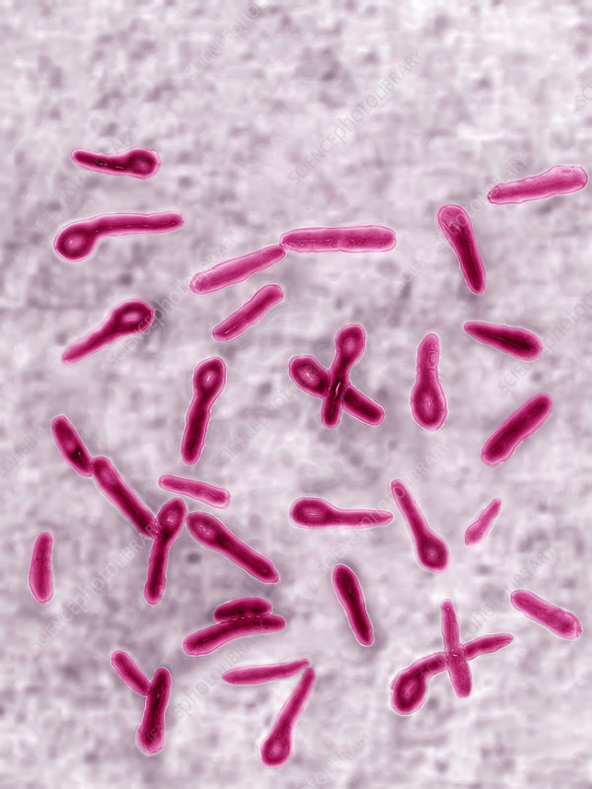
Tetanus
The disease tetanus is caused by the infectious agent Clostridium tetani.
C.Tetani without spore
C.Tetani with spore

Slide 39
Tetanus
C. tetani common soil bacterium
Usually rod shaped
It is a spore-forming anaerobic bacterium
Meaning outside the host, the pathogen is in spore form & can survive adverse conditions
C.Tetani without spore
C.Tetani with spore

Slide 40
Tetanus
Become enlarged & tennis racket/drumstick shaped when forming spores
The bacterial spores will only germinate & undergo asexual reproduction (binary fission) in the absence of oxygen
Clostridium tetani is an obligate anaerobic Gram-positive bacillus.
C.Tetani without spore
C.Tetani with spore

Slide 41
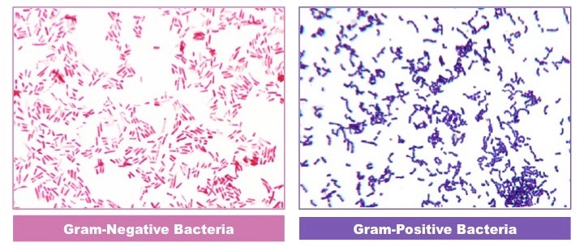
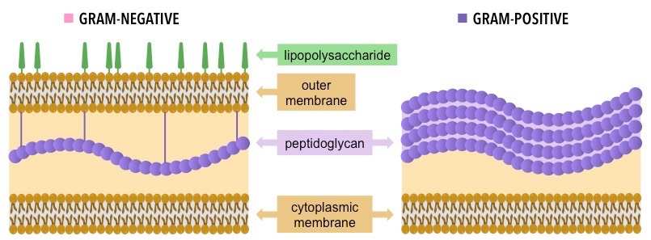

Slide 42
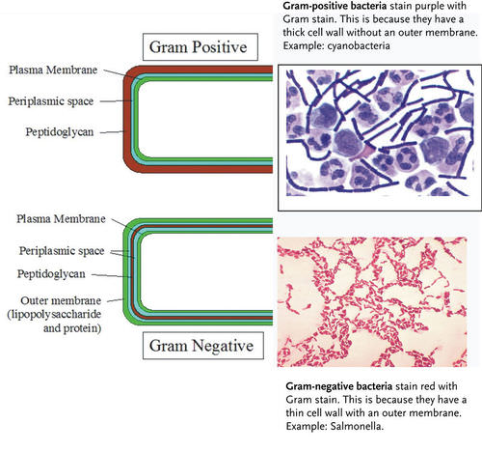

Slide 43
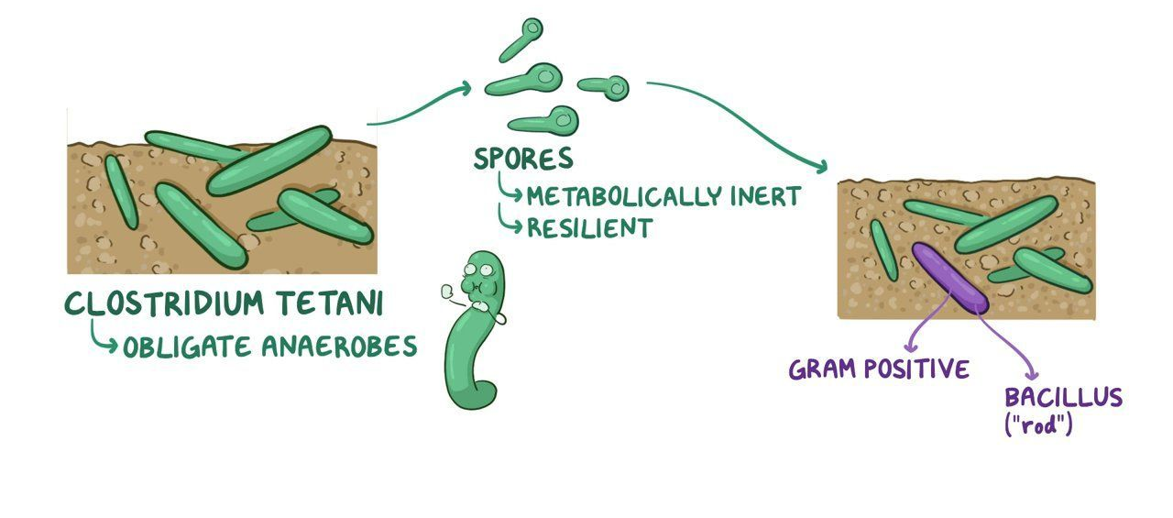
Tetanus
Clostridium tetani like all bacteria in the Clostridia family, are obligate anaerobes, meaning that oxygen is toxic to them.
In nature, they thrive in deep, compact soil, and when they feel the stress of fresh oxygenated air, they often produce spores, which are metabolically inert and extremely resilient to the environment.
Then, when environmental conditions improve, the spores are able to sprout into fully fledged Clostridia.

Slide 44
Tetanus
Entry into a susceptible host involves contact with the spore form of the bacterium, universally present in soil, typically via a deep wound.
The spores are also found in animal intestines and faeces.
The bacterial spores will not germinate in a superficial wound because they are anaerobic bacteria and will only germinate and multiply in hypoxic (low oxygen) conditions.
Wounds that penetrate deeply into skin and soft tissues provide the hypoxic conditions required for germination of the spore and a portal of entry.

Slide 45
Clostridium tetani life cycle
1 Soil reservoir
Soil particles containing bacteria spores can be found on rusty nails and on dog’s teeth.
2 Mode of transmission
Entry portal is via a deep wound in the skin involving direct contact with the soil reservoir (such as by stepping on a nail or being bitten by a dog).

Slide 46
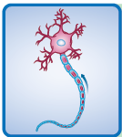
Clostridium tetani life cycle
3 Reproduction
Inside the deep, hypoxic wound, bacteria spores germinate, grow and multiply asexually via binary fission.
4 Production of toxin
During the growth of the bacteria, neurotoxins are produced (e.g. tetanospasmin), which travel inside neurons from the peripheral nervous system (PNS) to inhibitory interneurons in the central nervous system (CNS).

Slide 47
Clostridium tetani life cycle
5 Impact on host
The toxin blocks inhibitory neurotransmitters and nerves fire continuously, producing rigidity, unopposed muscle contraction and spasm, including ‘lockjaw’ (muscles contract and can’t relax – now called trismus). This can affect respiration/breathing and lead to death.
6 Infectious, not contagious
The pathogen does not normally transmit from human to human.

Slide 48
Symptoms
Symptoms usually start between 3 and 21 days after infection and include:
    Muscle spasms, especially in the face and neck
    Painful fits that can last for minuets
    Not being able to open your mouth (lockjaw)
    Swallowing problems
    Breathing problems
    Heat problems
    Fever

Slide 49
Symptoms
Tetanus can affect people of any age. Its is rare in Australia because most people are immunized. Those at high risk include:
  People not immunized & people who have not had a booster immunization in the past 10 years
  Most deaths from tetanus occur in people aged 70 years and over

Slide 50
Go to the link below for Prevention & Treatment information
https://www.ecdc.europa.eu/en/tetanus/facts

Slide 51
Prevention & Treatment (management strategies)
Immunisation- booster shots req.
Don’t handle rusty/tetanus prone items e.g rusty nails, rusty fences without wearing protective gear e.g gloves, shoes

Slide 52
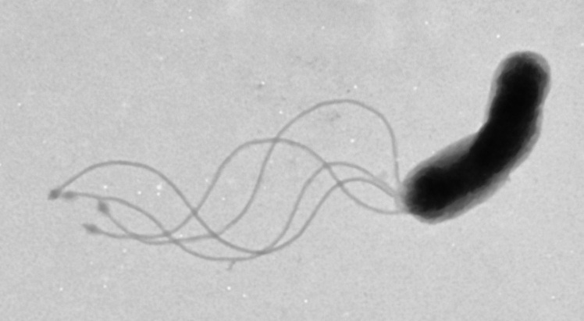
7 Crown gall disease
Crown gall disease of plants is caused by the infectious agent Agrobacterium
tumefaciens.

Slide 53
Crown gall disease mode of tranmission
Bacteria can be transmitted from one host to another directly (via infected plant root to susceptible plant root contact) or indirectly (via grafting tools, car tyres, infested soil reservoirs, or movement of infested soil [such as by work boots or rain]).
Like the tetanus bacterium, A. tumefaciens requires a wound as a portal of entry. Unlike tetanus, the wound does not have to be deep.
The disease can spread through susceptible crops such as stone fruits and roses.
The disease can be found throughout Australia and has been a minor
disease in roses and stone fruits in WA.

Slide 54
Impact on Host & Symptoms
Infection involves the induced growth of tumour-like galls around the stem of plants and the roots.
When the pathogen enters a wound, it inserts a gene from its plasmid into the genome of the host cell
Then the Agrobacterium bacteria genes are expressed in the plant which results in the production of some hormones causing rapid cell growth and the formation of galls.

Slide 55
Impact on Host & Symptoms
Can also change the expression of some plant genes
The galls are malformed growths that become a barrier in the infected host plant’s transport system for water and nutrients, causing the plant to wilt and have stunted growth.
Plant may even die

Slide 56
Crown gall disease
This illustration shows severe gall infection at the crown area on the roots (the point at the soil line where the main roots join the stem).

Slide 57
Agrobacterium tumefaciens life cycle
Bacterial spores are released from infected plant galls. Use flagella to swim to plant
Direct/indirect modes of transmission – spores are transmitted by contact or by vehicle into wounded roots in a susceptible plant – the portal of entry through a wound. The bacteria is attracted by the sugars/chemicals released by the wound

Slide 58
Agrobacterium tumefaciens life cycle
3 Bacterium invades through the wound and attaches to a wounded plant cell and multiplies..
4 Bacterium transfers a plasmid into plant cells. Plasmid contains genes for uncontrolled cell growth. DNA permanently integrates into the plant genome

Slide 59

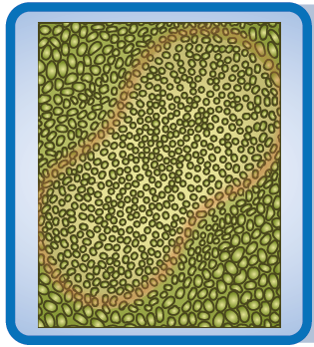
Agrobacterium tumefaciens life cycle
5 Plant cell genome transforms and starts to divide, rapidly forming galls.
6 Galls grow around the crown of the plant and stunted plant growth results.
7 Spores can be released to continue the cycle.

Slide 60
Prevention & Treatment
Best Management Strategy is to disrupt the pathogen life cycle to prevent the disease as there is no cure
Quarantine
Plants need to be monitored for signs of the disease
Affected plants destroyed or isolated from healthy plants
Soil around the plants affected should be removed & disposed of by burning or treated with heat as the bacterium is soil-borne
Redirect runoff, especially during rainy seasons because the spread can be spread by water

Slide 61
Prevention & Treatment
Hygiene
Garden tool should be disinfected because the bacterium can be spread via these tools
Wash doen tyres & boots when leaving a contaminated area to prevent spread
Medications/Treatment
Surgically remove gall from tree. Then apply heat to dry & sterilise the area around the gall. Monitor regrowth is required every few months. This is costly & labour intesive
Treat the plants with a biological control agent to prevent infection
https://www.dpi.nsw.gov.au/agriculture/horticulture/pests-diseases-hort/information-for-multiple-crops/crown-gall-of-plants

